Slide 1
CSS transforms, Animations, grid systems responsive design and CSS preprocessors
IN712 Web 3

Slide 2
In-Browser Animation
HTML5 and CSS3 have introduced animation facilities supported directly by the browser.
HTML5 introduces the <canvas> element. This is a normal tag that you drop in just like you drop in a <p> or <div>
The canvas element provides a full range of drawing commands
You use these *from JavaScript*. That is, you pop a canvas into your html, then grab it in JavaScript.
You then invoke its methods in the usual OO way.
We will, therefore, defer discussion of HTML5 canvas animation until we meet JavaScript
Today, we will turn our attention to animation facilities of CSS3
So what are transforms and transitions? At their most basic level, transforms move or change the appearance of an element, while transitions make the element smoothly and gradually change from one state to another.
HTML5
<canvas>
CSS3
Transforms
Transitions
Animations

Slide 3
CSS transforms
Transformations make an element change from one state to another. With the CSS transform property you can apply the following transformation to any HTML element
Rotate
Move
Skew
Scale
And many others
Transforms are usually triggered when an element changes states, such as on mouse-hover or mouse-click.

Slide 4
CSS transitions
Transitions are the grease in the wheel of CSS transforms. Without a transition, an element being transformed would change abruptly from one state to another. By applying a transition you can control the change, making it smooth and gradual.

Slide 5
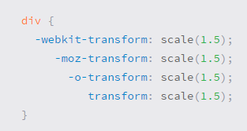
A word about vendor prefixes
CSS vendor prefixes are a way for browser makers to add support for new CSS features before those features are fully supported in all browsers
the transform property should be use with multiple vendor prefixes to gain the best support across all browsers
The un-prefixed declaration comes last to overwrite the prefixed versions, should a browser fully support the transform property
Vendor prefixes are strongly encouraged for any code in a production environment

Slide 6
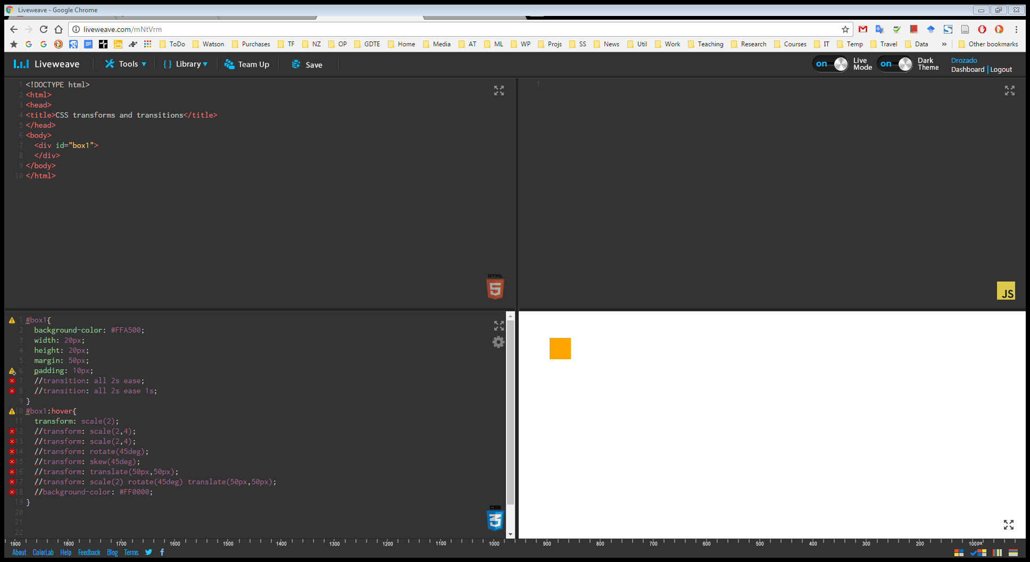
Demo: CSS transforms and transitions

Slide 7
CSS3 Keyframe Animation
The @keyframes CSS rule lets authors control the intermediate steps in a CSS animation sequence by establishing keyframes (or waypoints) along the animation sequence that must be reached by certain points during the animation.
The browser will tween the key frames for you
This is a two-step process: First we define the animation, then we assign it to an element
Define the animation
@keyframes animationName
{
Keyframe specifications
}
Assign the animation
selector
{
Other styles
animation: name duration timing-function delay iteration-count direction;
}

Slide 8
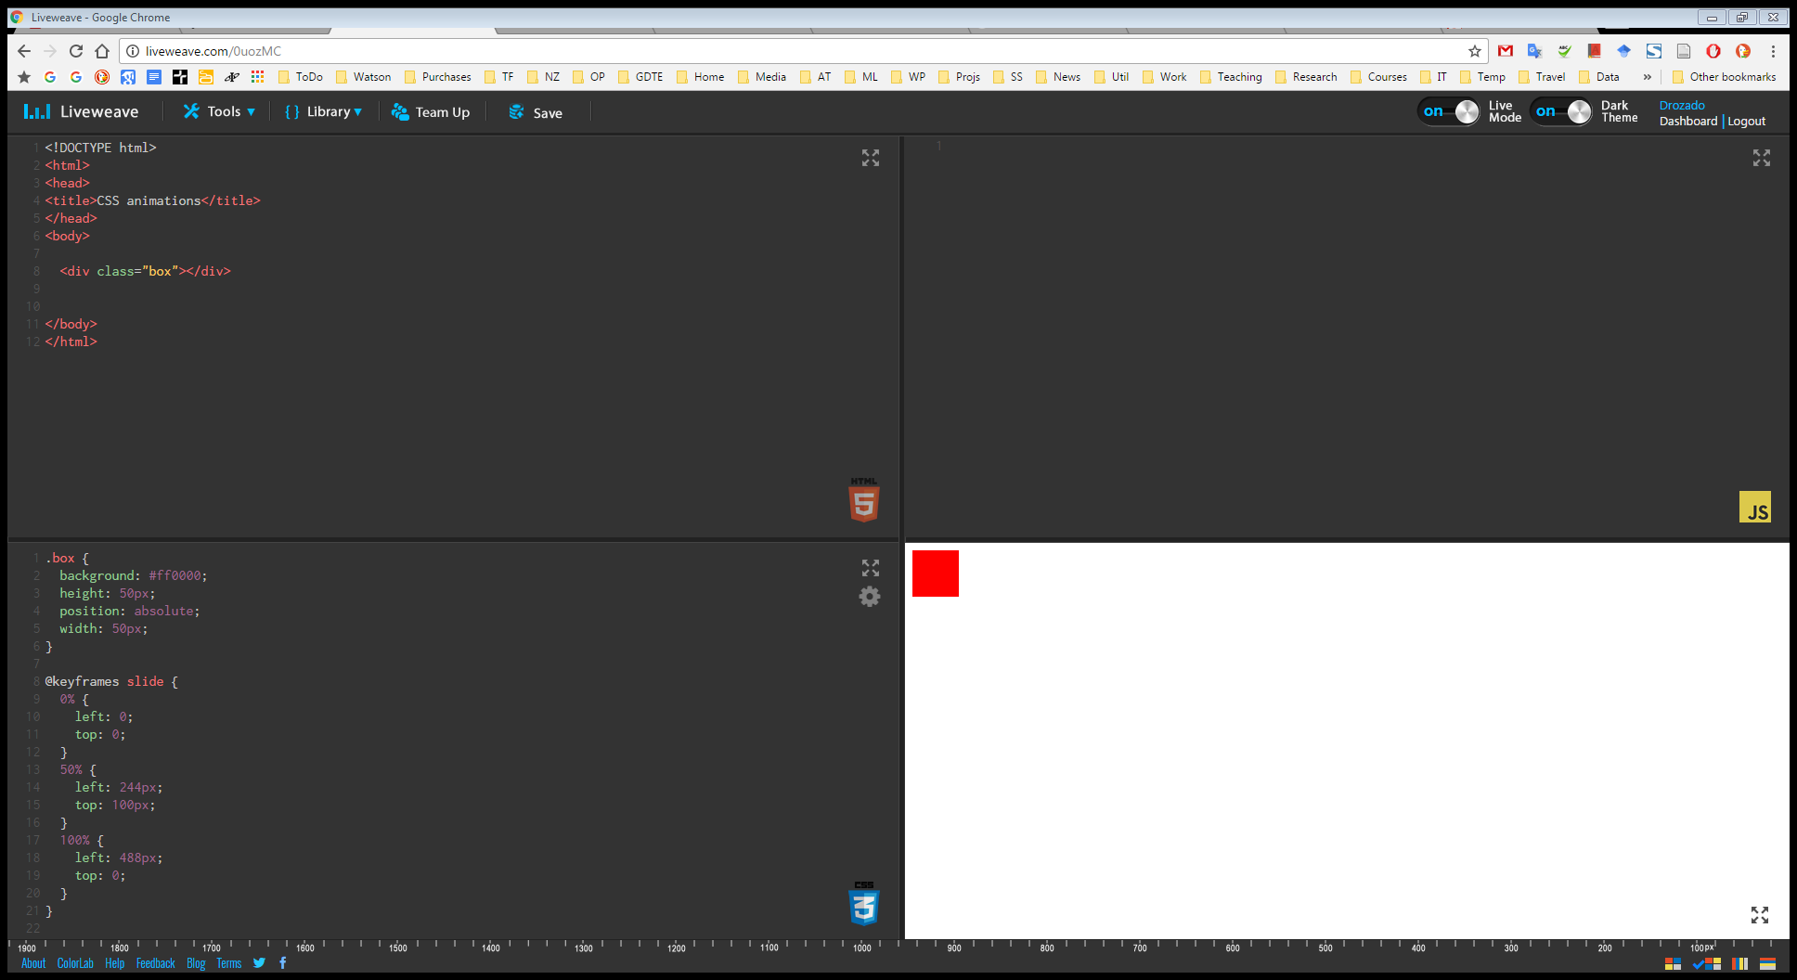
Demo

Slide 9
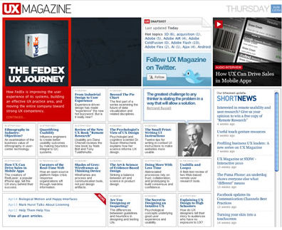

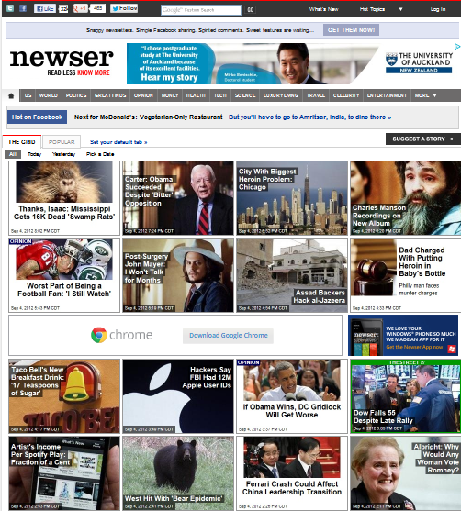
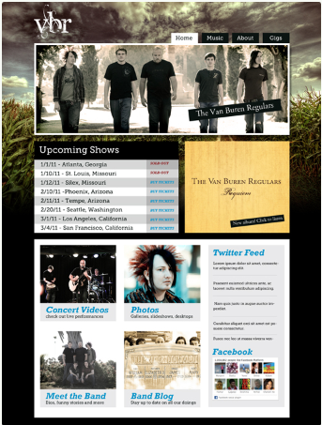
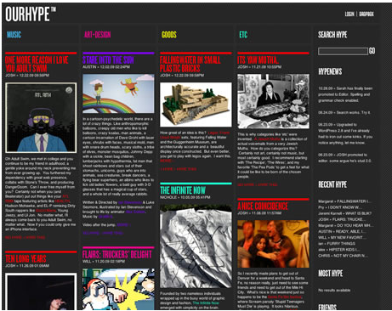
CSS frameworks
CSS Frameworks are collections of useful styles that can save you a lot of work
So a CSS framework is a precreated set of CSS classes or other software tools that make it easier to use and work with CSS.
For example, a common sort of framework is the grid system
Artistic considerations aside, most web pages used some kind of column, row layout. There are lots of colspans and rowspans, but everything is pretty much lined up
Making columnar layouts used to be done with tables, but that was too rigid (or something) so everyone switched to doing it with CSS
Absolute positioning
Floating elements
Laying out columns with CSS is a continuing nightmare of floating and clearing and tweaking pixels of margin and padding, and is basically awful
So somebody said “let’s write this stuff up once and use it over and over…”
And that’s a grid system

Slide 10
Grid systems
Grid systems make it easier to create multicolumn layouts. There are many CSS grid systems; some of the most popular are:
Bootstrap (twitter.github.com/bootstrap)
Blueprint (www.blueprintcss.org)
960 (960.gs)
Skeleton (http://getskeleton.com/)
Most provide somewhat similar capabilities. The most important of these capabilities is a grid system
Print designers typically use grids as a way to achieve visual uniformity in a design.
In print design, the very first thing a designer may do is to construct, for instance, a 5- or 7- or 12-column grid in a page layout program
CSS frameworks provide similar grid features.
The 960 framework uses either a 12- or 16-column grid
Bootstrap uses a 12-column grid.
Blueprint uses a 24-column grid.

Slide 11
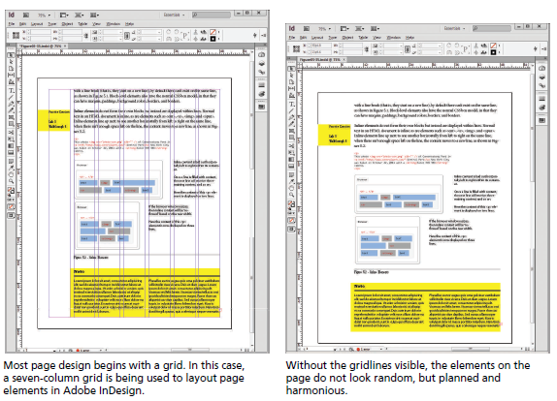
Using a grid in print design

Slide 12
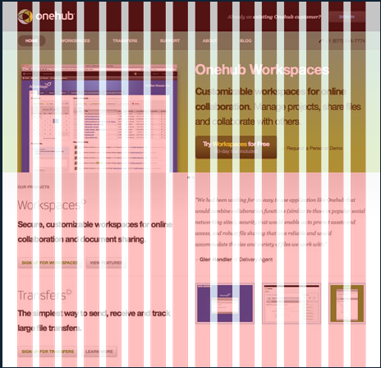
CSS Grid Systems
960 Grid System (URL: 960.gs)
Makes layouts 960 pixels wide
Automates set up of columns
There are (again) lots of these, but this is common/popular and stable.
960 is a good width for 1024x768 screens, allowing for margins and other schmutz.
Lots of professional designers just start everything with a width:960px wrapper div.
What 960 lets you do is automatically get that area divided up into 12 or 16 skinny columns that you then recombine as required to get the layout you want.

Slide 13
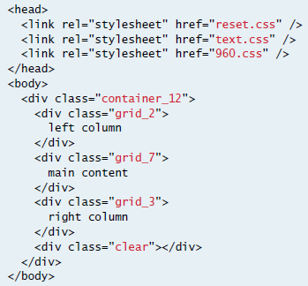
Using the 960 grid

Slide 14
960 Grid System
The 960 Grid System is an effort to streamline web development workflow by providing commonly used dimensions
Based on a width of 960 pixels.
There are two variants: 12 and 16 columns
can be used separately or in tandem
The 12-column grid is divided into portions that are 60 pixels wide.
The 16-column grid consists of 40 pixel increments.
Each column has 10 pixels of margin on the left and right, which create 20 pixel wide gutters between columns.

Slide 15
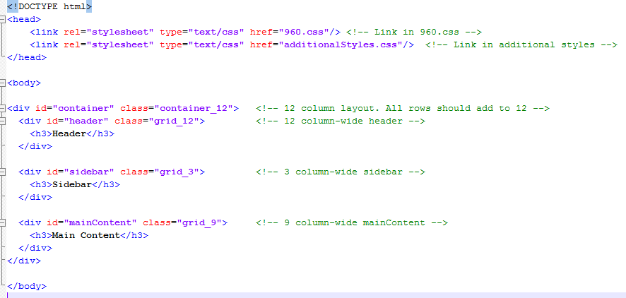
960 Grid System

Slide 16
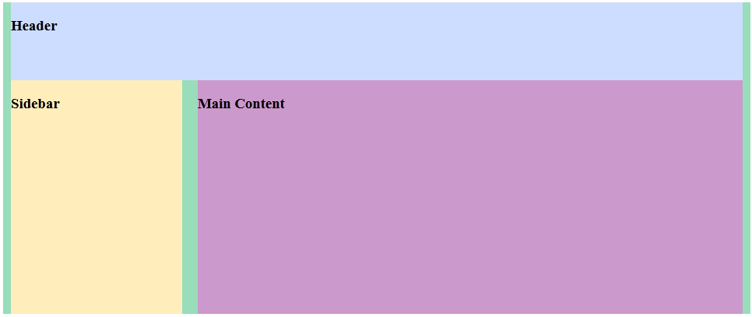
960 Grid System
Magic! No floats, no widths, no nothing…

Slide 17
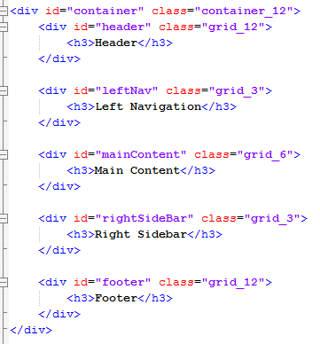
960 Grid System

Slide 18
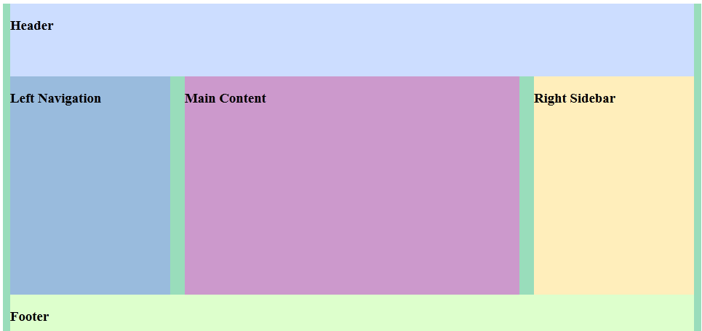
960 Grid System

Slide 19
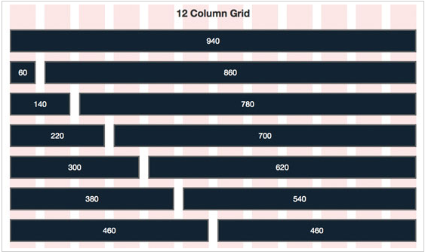
960 Grid System

Slide 20
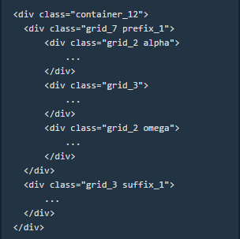
960 Grid System
Classes for fine tuning:
prefix_n: Add n columns of white space before this div
suffix_n: Add n columns of white space after this div
If a grid unit contains grid children:
alpha: This column is the first in the row, set left margin to 0
omega: This column is the last in the row, set right margin to 0

Slide 21
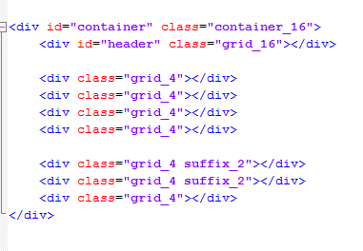
960 Grid System
Here’s a 16 column layout with suffixes
That bottom row uses (4+2) + (4+2) + 4 to get up to 16
If we drop a paragraph of text into each div, it looks like what is shown in the next slide

Slide 22
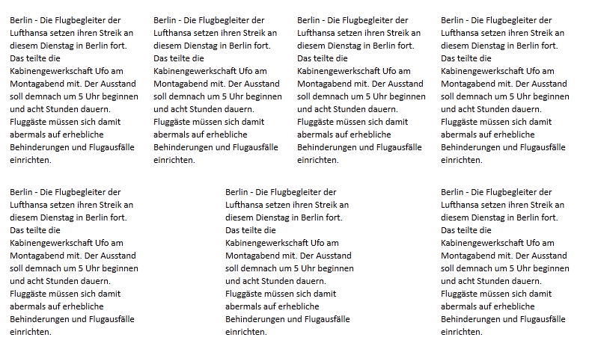
960 Grid System

Slide 23
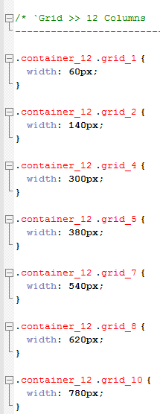
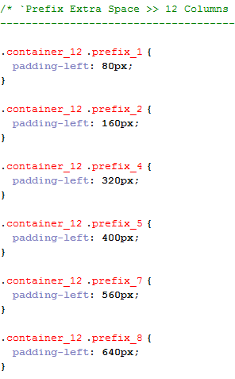
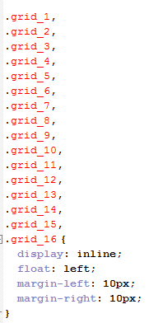
What is in the 960.css file?

Slide 24
960 Grid System
Objections?
Fixed width layout
which means it doesn’t work at tablets/phones etc. A system using percentages rather than pixels would resize gracefully. This won’t
Not semantic
Remember the whole point of separating CSS and HTML was to get format out of the HTML and have all the elements in the HTML be meaningful. It’s pretty hard to argue that “grid_6” is in any way meaningful. So it’s no use to SEO, text readers, other bots, etc.
However, much of this objection can be countered with careful use of additional classes.

Slide 25
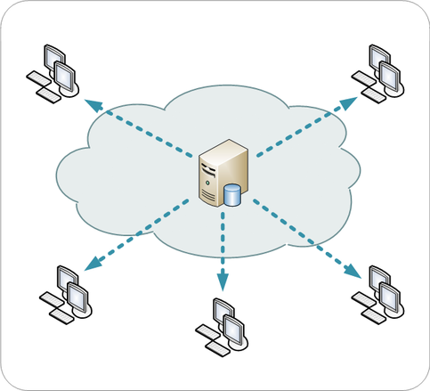
A word about content delivery networks (CDNs)
A content delivery network or content distribution network (CDN) is a globally distributed network of proxy servers deployed in multiple data centers.
The goal of a CDN is to serve content to end-users with high availability and high performance.
CDNs serve a large fraction of the Internet content today, including web objects (text, graphics and scripts), downloadable objects (media files, software, documents), applications (e-commerce, portals), live streaming media, on-demand streaming media, and social networks.

Slide 26
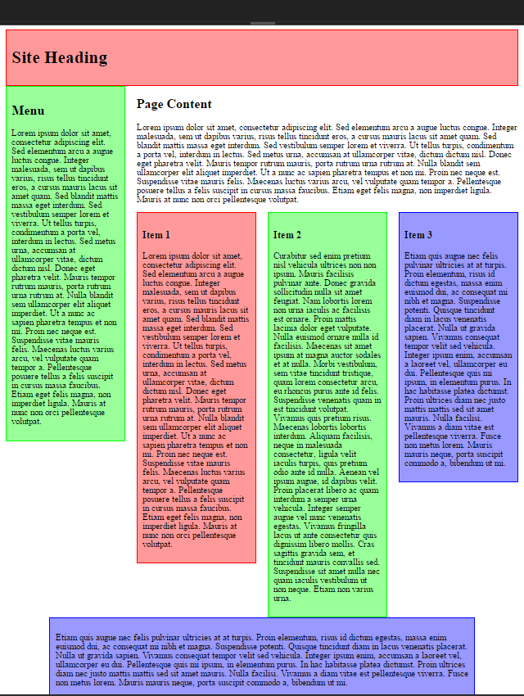
Demo

Slide 27
When creating a website, should you:
Optimize for the desktop user
Optimize for the mobile user
Find a compromise between both

Slide 28
2 alternatives
Separate Sites | One site (Responsive Design)
Fine tuned for performance Fine tuned for use cases Optimized for mobile extended capabilities like geolocation | Equal content access for all Reduced maintenance burden When done well, forces lean content design

Slide 29
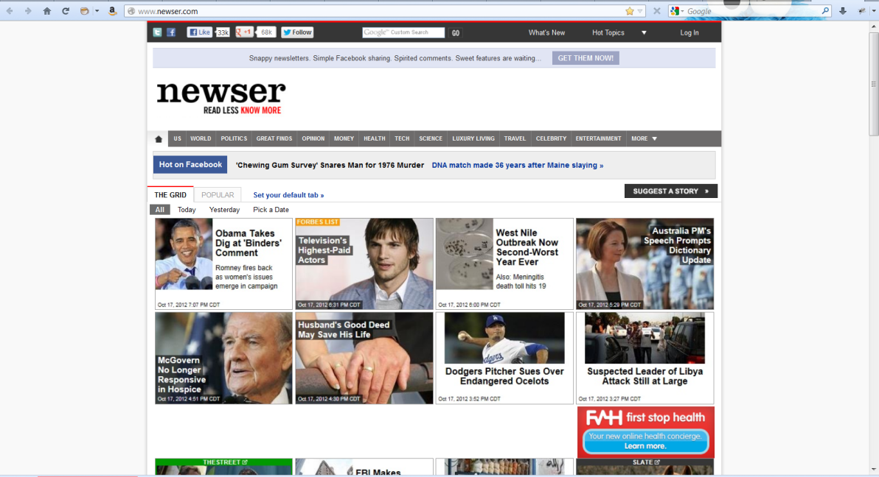
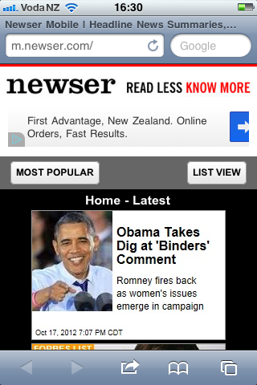
Separate Mobile Sites
Notice the different URL
Newser.com, given as the URL to Safari on an iPhone, automatically redirects to m.newser.com
Newser.com, on a desktop browser

Slide 30
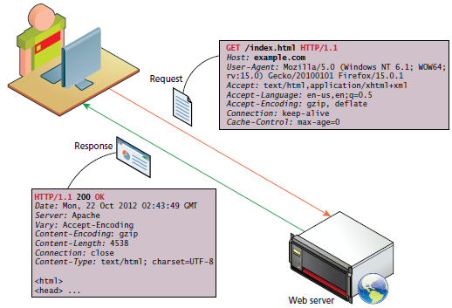
Implementation: Separate Mobile Sites
The process goes like this….
Sites are built
Server-side device detection
The server grabs incoming http requests and figures out who they come from
Web browsers send a User-Agent header as part of the HTTP request whenever the browser sends a request for a web page or resource
The User-Agent header contains information about the browser, including kind, version, and so forth
Hard to understand? Yes.
Reliable syntax? No.
Different formats used by all of the 1000s of device x OS x browser combinations in the world? Yes.
Server tries to deliver appropriate page
You get either the regular page or the mobile page.

Slide 31
Server Side Device Detection
User-Agent Header Sniffing

Slide 32
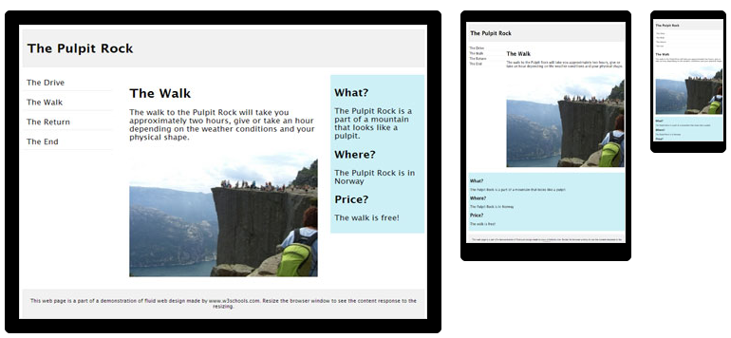
Responsive Web Design
Responsive web design (RWD) is an approach to web design aimed at crafting sites to provide an optimal viewing and interaction experience—easy reading and navigation with a minimum of resizing, panning, and scrolling—across a wide range of devices (from desktop computer monitors to mobile phones).

Slide 33
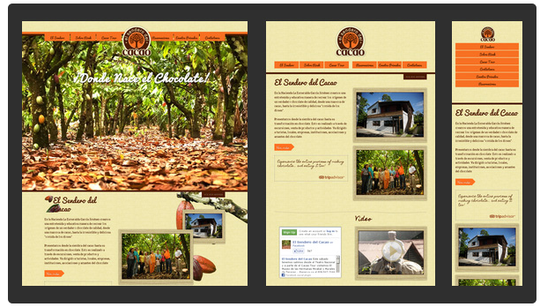
Responsive Web Design

Slide 34
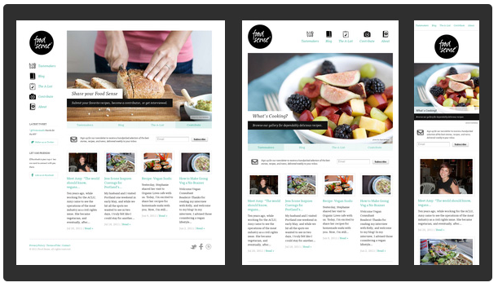
Responsive Web Design

Slide 35
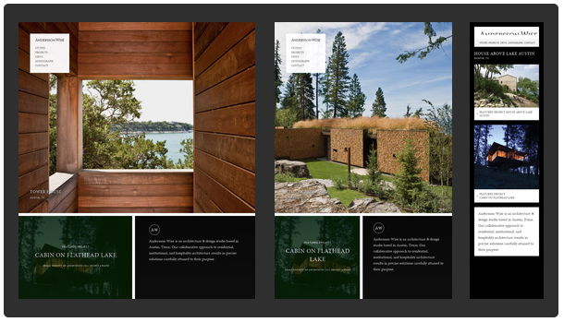
Responsive Web Design
http://www.anderssonwise.com/

Slide 36
Note about responsive web design
Note: A responsive site changes its layout as the size of the browser window changes (it can change based on other properties as well, but in practice, it is the size – particularly the width – of the browser window that is the critical property)
To test how your site really works on mobile, you should look at it on mobile. But during development, you can see the effects simply be resizing the browser
However, you need to be a little careful about putting too much faith in this method

Slide 37
Implementation: RWD
Three core techniques:
Media queries
Fluid grids
Fluid media

Slide 38
Implementation: RWD
Media Queries
Allows “conditional CSS”
Logically:
If screen is at least x pixels wide
Do this CSS
If screen is less than x pixels wide
Do this other CSS

Slide 39
Media Queries
The CSS is applied only if the media query evaluates to true
@media mediaType and mediaFeatures
{
conditional CSS rules
}
MediaType can be screen, print, braille, tty, and a number of others, but for our purposes, we are interested in ‘screen’
There are a variety of media features, and an assortment of conditional operators.

Slide 40
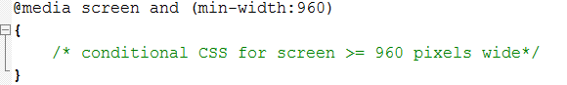
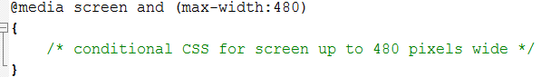
Media Queries
Syntax
Note the syntax: use a ‘:’ not an ‘=‘
Min-width = “at least as wide as”
Max-width = “no wider than”
Note that these are not properties of the device, they are the current width of the browser window.

Slide 41
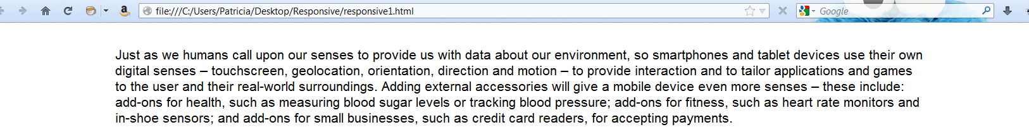
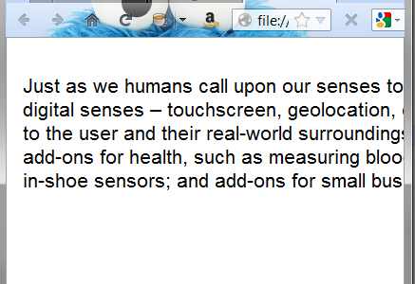
No Media Queries
Ordinary web page…
If we resize the browser to simulate a smaller screen, the page looks like this….
Specifically, the text is cut off. The div remains at 960 pixels wide, even though the window is not that wide. It’s not shown in this picture, but you get a horizontal scroll bar at the bottom of the screen, which is hateful.
Now try adding a media query to your css…

Slide 42
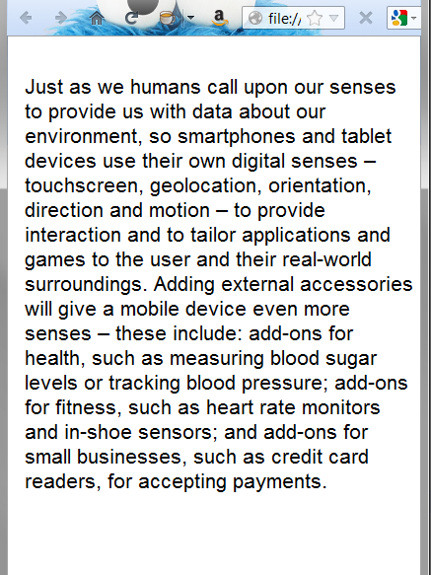
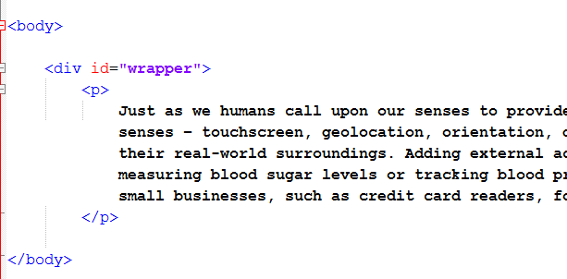
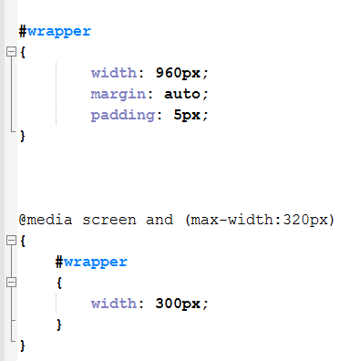
Media Queries

Slide 43
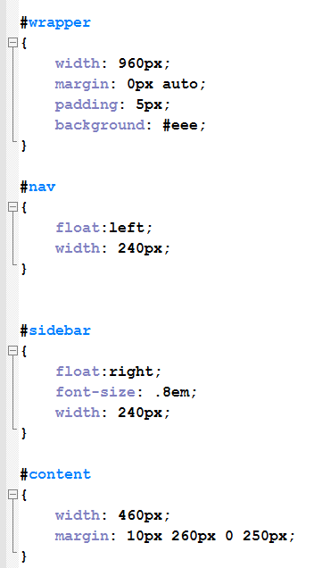
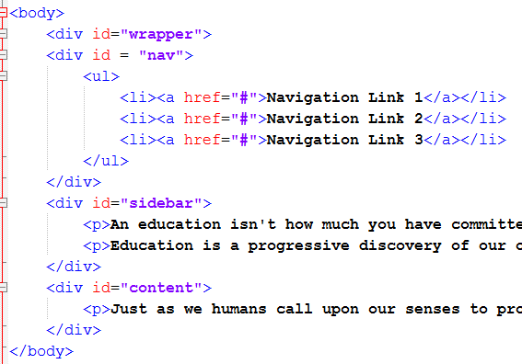
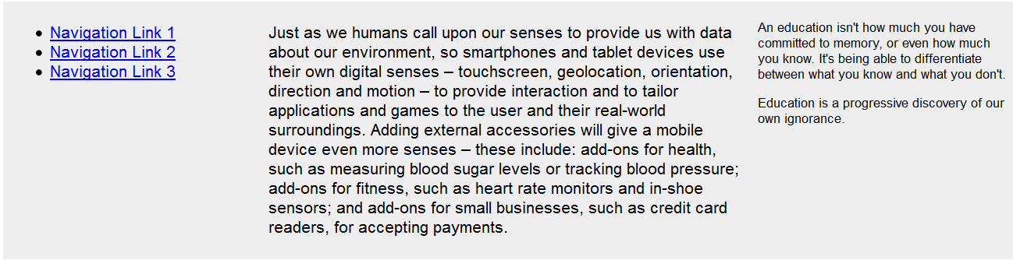
Vanilla webpage

Slide 44
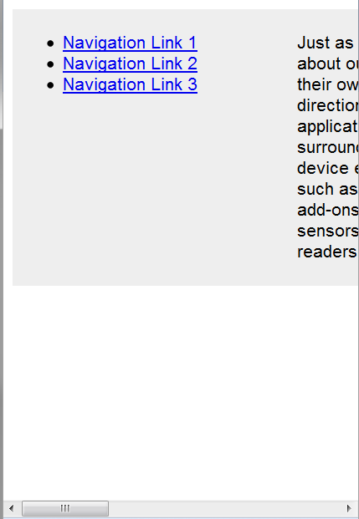
When resized:
So how would you fix this for a small screen?
You need to do two things:
Quit having everything be 960
Put everything in one column

Slide 45
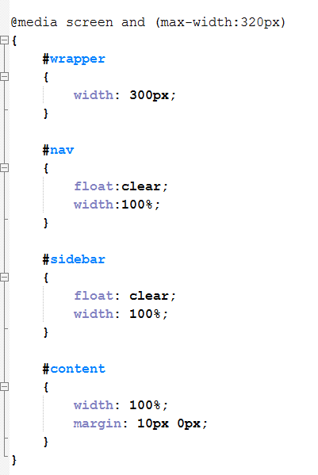
Media Queries
Here’s the CSS to override the default styles that we want to change.
Different widths and clear the floats
Note that, in addition to clearing the floats and margins we are using width:100%
This is another important piece of RWD we’ll talk more about later.
The logic is, if you don’t know how big the screen is going to be, don’t give an absolute size.
Think in terms of “fill the whole width” or “fill 1/3 or the width”, etc.
It is important to note that, in CSS, %age widths are determined relative to the containing element in the DOM not relative to the window.
Some more example in a moment.
Now at full-screen, our page looks exactly the same. But at 320….

Slide 46
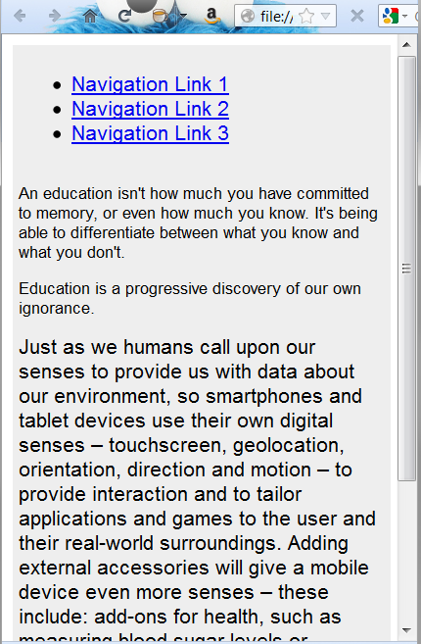
Media Queries
You can see it change abruptly as you resize the browser window.
The point at which it changes is called a “breakpoint”.
In this example, we have one breakpoint at 320 px.
Note that you can have as many media query blocks and thus as many breakpoints as you want.
By using different values of min-width and max-width, you can target all the specific device sizes you care about, for example: phone, iPad, desktop.
We’ll talk about breakpoints some more in just a minute….

Slide 47
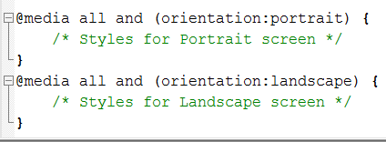
Media queries for Device orientation

Slide 48
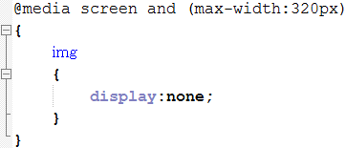
Media Queries
Making elements disappear
Set display:none
Using this technique you can provide lots of contents when the browser is big and not have to worry about it cluttering things up when the browser is small.
Any problems with this that you can think of? =>Display:none hides content, it doesn’t remove it
Thus content that’s in the default html & CSS (so not including images assigned via background url) is downloaded to the browser whether it’s hidden or not.
One of the big issues around web for mobile is reduced bandwidth and slow download times, so this is a problem.
Solutions? => Make the mobile content the default, and add with media queries for larger screens.

Slide 49
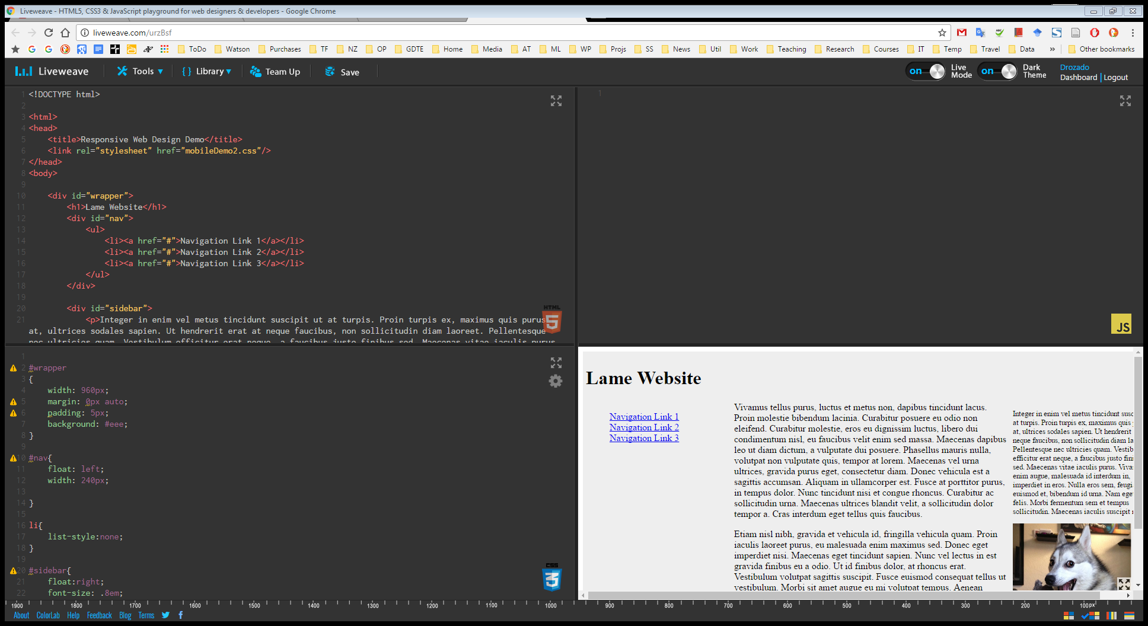
Demo
http://liveweave.com/urzBsf

Slide 50
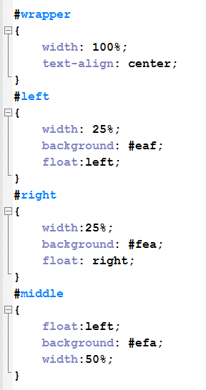
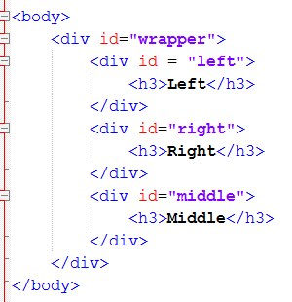
Fluid Grids
Specify element widths as percentages of their containing element
The second cornerstone of RWD

Slide 51
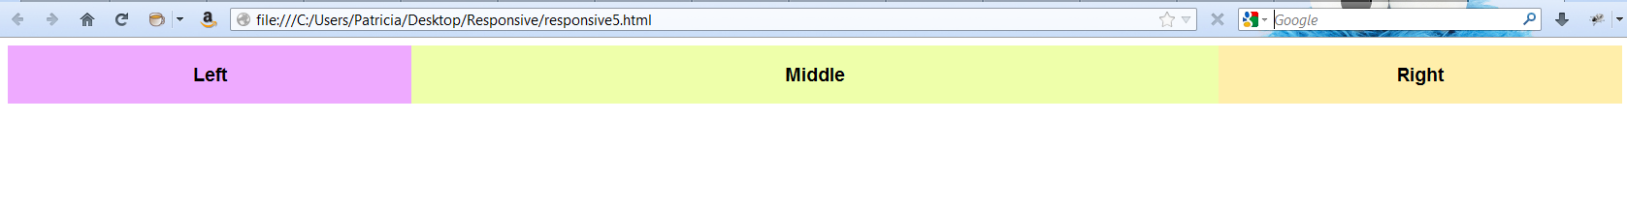
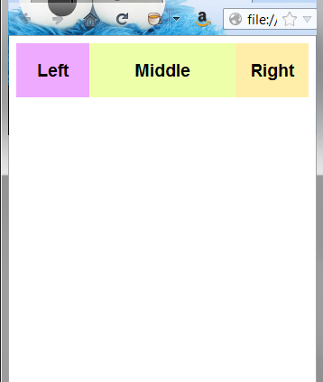

Fluid Grids
NO media queries here, just the divs resizing themselves to a percentage of the containing element.
There are complexities with dealing with the content and allowing for borders, margins and paddings, but this is the basic idea.

Slide 52




Fluid Media

Slide 53

Demo

Slide 54

Breakpoints
http://www.netmagazine.com/tutorials/determining-breakpoints-responsive-design

Slide 55
Breakpoints
Just one of the complexities of RWD.
Essentially you are being asked to write cascading CSS for all the important breakpoints
The general suggestion is to serve different physical style sheets at the major breakpoints (done by using media queries in the <link>) and using embedded media queries for the minor break points.
You end up writing a lot of CSS. So if you thought the advantage of RWD over dedicated mobile sites was having to write less CSS, that was wrong.
Remember that Google Chrome developer tools has a very useful tool to test RWD

Slide 56

Making the iPhone Behave
This is what the ODT looks like on iPhone.
This happens because Safari on iOS pretends to be 960 pixels wide. When fully zoomed out (i.e. normal), it makes teeny tiny pixels.
The logic is that users will want to get the full site, and are willing to zoom and pinch to read and navigate.
If you have written a responsive site, you want the browser not to do this. You want it to say it’s 320 pixels when it is.
To enforce this behaviour, you simply add a line to the <head> section of your website.

Slide 57

Making the iPhone Behave
Some mobile devices squishes down webpages to really, really tiny versions.
This is due to the mobile browser pretending to have a larger screen resolution that it really has
The <meta> tag below sets width=device-width so that the browser admits to being its real size, not the pretend size.

Slide 58
Two different design philosophies
Graceful Degradation
Progressive Enhancement
Full desktop is default
If reduced features detected
Degrade content
Eliminate or simplify functionality
If using media queries, you might hide elements with display:none, or swap in smaller images for background-image
Minimal browser is default
If enhanced features detected
Upgrade content
Add functionality
Use your js to add in HTML5 graphics when you detect the <canvas>, but if it’s not detected, have something in place that works (perhaps some text-based solution). Nobody every sees “you are missing some content because of your hardware”.

Slide 59
Great Examples of RWD
http://www.anderssonwise.com/
http://stephencaver.com/
http://seesparkbox.com/
http://foodsense.is/
http://www.bostonglobe.com/
http://forefathersgroup.com/
http://spigotdesign.com/
http://ribot.co.uk/
http://www.authenticjobs.com/
http://www.cacaotour.com/index.php/en/home
http://www.stpaulsschool.org.uk/

Slide 60

CSS preprocessors
CSS, as a language has its own feature set, which at times might not be enough to create a clean and reusable chunk of rules.
Not being able to reuse a collection of rules in multiple selectors
unavailability of variables which may lead to ambiguous pieces of data across the stylesheet
To overcome most of these limitations, the concept of a preprocessor was born
Preprocessors offer an advanced way of writing CSS, which extends the basic functionalities. This advanced code is later compiled as normal CSS code using respective compilers (which depends on what preprocessor you are using), which the browser will understand
CSS preprocessors:
Less
Sass
Stylus
Turbine
switch CSS
Pcss

Slide 61
Sass Installation
Detailed installation
Before you start using Sass you will need to install Ruby.
The fastest way to get Ruby on your Windows computer is to use Ruby Installer.
It's a single-click installer that will get everything set up for you super fast.
Open your Terminal or Command Prompt
Install Sass
gem install sass
You should now have Sass installed, but it never hurts to double-check. In your terminal application you can type:
sass –v
It should return your sass version
Once you start tinkering with Sass, it will take your preprocessed Sass file and save it as a normal CSS file
sass input.scss output.css
You can watch either individual files or entire directories for sass to monitor changes to .scss an automatic generation of .css output
sass --watch folderName

Slide 62


Variables
Think of variables as a way to store information that you want to reuse throughout your stylesheet
You can store things like colors, font stacks, or any CSS value you think you'll want to reuse
Sass uses the $ symbol to make something a variable
When the Sass is processed, it takes the variables we define for the $font-stack and $primary-color variables and outputs normal CSS with our variable values placed in the CSS
This can be extremely powerful when working with brand colors and keeping them consistent throughout the site
SASS
preprocessing

Slide 63


Nesting
When writing HTML you've probably noticed that it has a clear nested and visual hierarchy. CSS, on the other hand, doesn't.
Sass will let you nest your CSS selectors in a way that follows the same visual hierarchy of your HTML.
This is a great way to organize your CSS and make it more readable.
Be aware that overly nested rules will result in over-qualified CSS that could prove hard to maintain and is generally considered bad practice.
SASS
preprocessing

Slide 64



Import
CSS has an import option that lets you split your CSS into smaller, more maintainable portions
The only drawback is that each time you use @import in CSS it creates another HTTP request
Sass builds on top of the current CSS @import but instead of requiring an HTTP request, Sass will take the file that you want to import and combine it with the file you're importing into so you can serve a single CSS file to the web browser
You can create partial Sass files that contain little snippets of CSS that you can include in other Sass files. This is a great way to modularize your CSS and help keep things easier to maintain
A partial is simply a Sass file named with a leading underscore. You might name it something like _partial.scss
Let's say you have a couple of Sass files, _reset.scss and base.scss We want to import _reset.scss into base.scss
SASS
preprocessing

Slide 65


Mixins
Some things in CSS are a bit tedious to write, especially with CSS3 and the many vendor prefixes that exist.
A mixin lets you make groups of CSS declarations that you want to reuse throughout your site.
You can even pass in values to make your mixin more flexible.
To create a mixin you use the @mixin directive and give it a name.
We've named our mixin border-radius.
We're also using the variable $radius inside the parentheses so we can pass in a radius of whatever we want.
After you create your mixin, you can then use it as a CSS declaration starting with @include followed by the name of the mixin.
SASS
preprocessing

Slide 66


Extend/Inheritance
Using @extend lets you share a set of CSS properties from one selector to another.
SASS
preprocessing

Slide 67


Operators
Doing math in your CSS is very helpful.
Sass has a handful of standard math operators like +, -, *, /, and %.
SASS
preprocessing

Slide 68
Sass control directives
Sass control directives provide flow and logic and give you a finite level of decision making required by mixins and functions.

Slide 69


@if
The @if control directive takes a Sass script expression and processes its block of styles if the expression returns anything other than false.
Also notice the @debug followed by a string in each flow option. This is to show you how you can output a message to the command-line output log to let users know about certain events such as a @warn or a @debug as your code gets executed.
SASS
preprocessing

Slide 70


@for
@for $var from <start> through <end> which starts at <start> and loops "through" each iteration and ends at <end>
SASS
preprocessing

Slide 71
References
Fundamentals of Web Development

